Slide 1

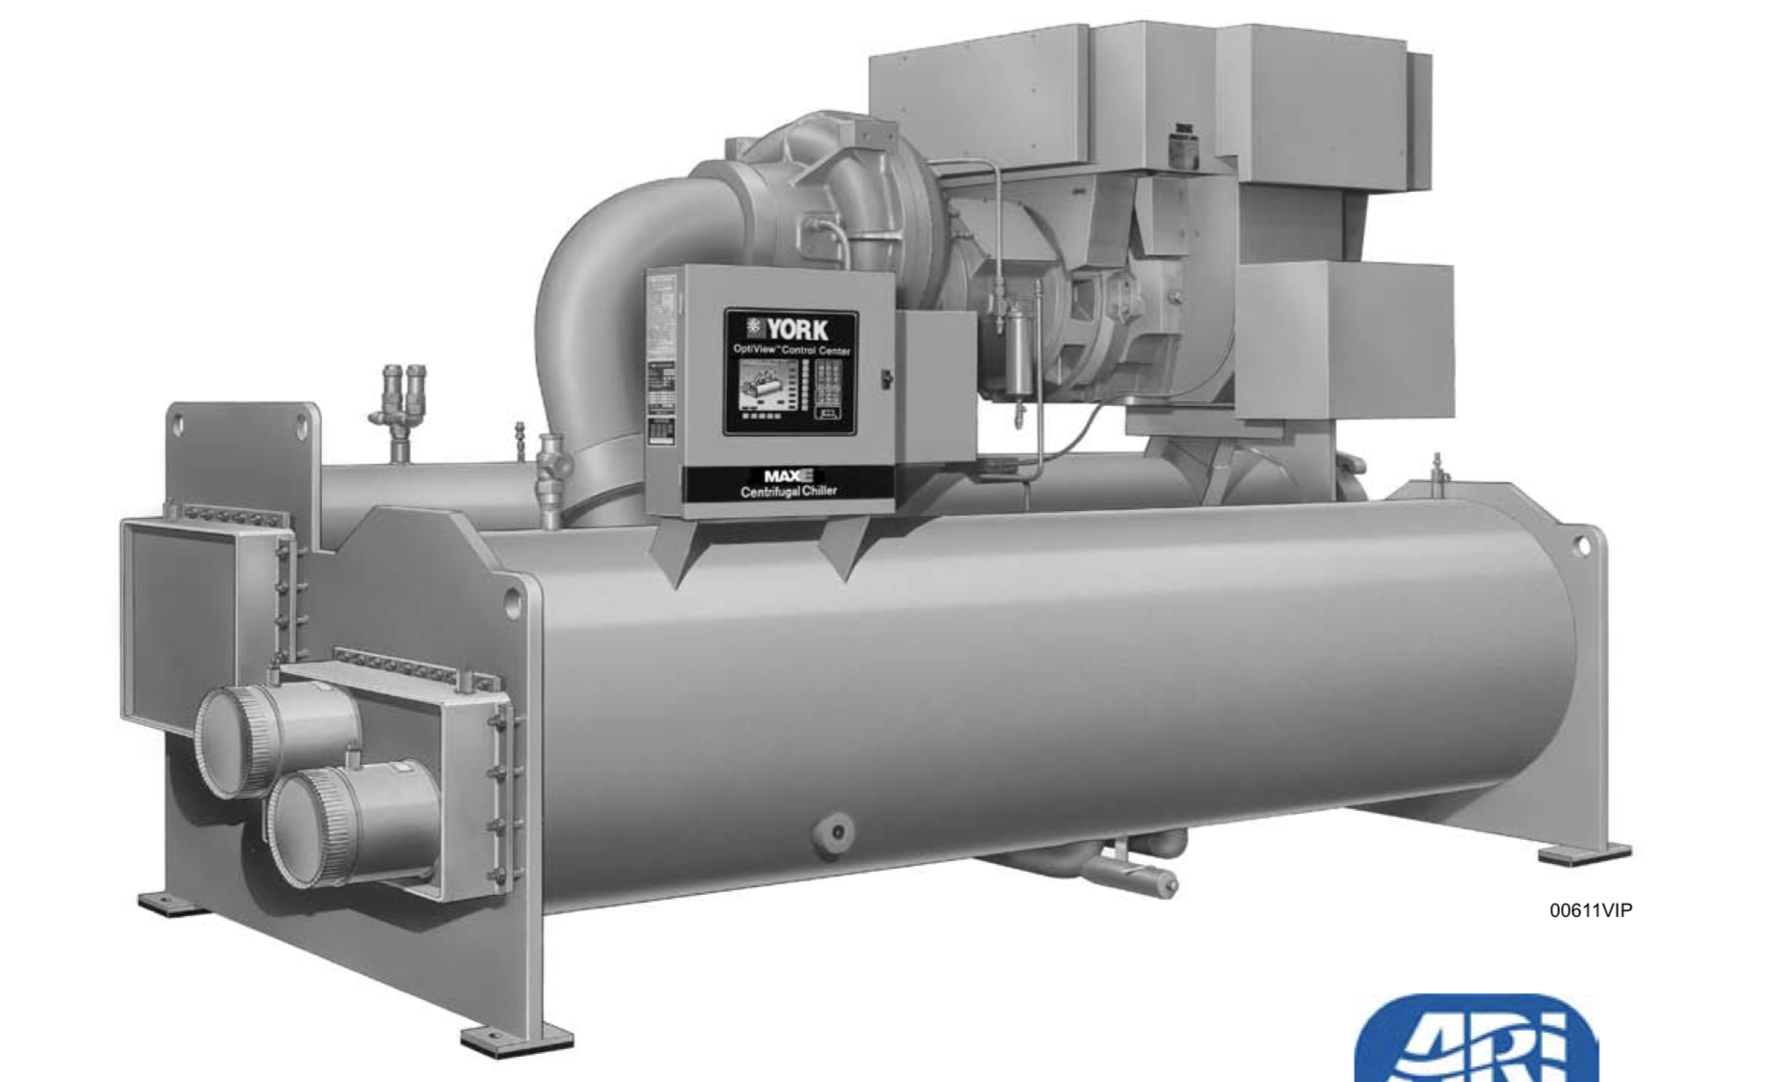



Prediction of Generalized Chiller Efficiency by using Machine Learning Method
Andrew Copsey*, Kailei Liu**,Hongbo Qiao*.
* Department of Materials Science and Engineering ** Department of Chemical Engineering
Introduction
Data Cleaning and ML Model
Results
Data Cleaning & Model Selection
By fitting with 24 unique chillers (58 in total) datasets we have , the polynomial function fitted the data very well.
Time Series Data
Date Screening
$Efficiency= \left(a_{1}∗{x_{1}}^{2}+a_{2}∗x_{2}+a_{3}\right)\left(a_{4}∗{x_{4}}^{2}+a_{5}∗x_{5}+a_{6}\right)$*
Raw Data
50+ features/chiller
Feature Elimination
Non-numeric Features
Data Numeralization
Centrifugal chillers are large, centralized refrigeration machines often used to generate cooling for large HVAC systems. Chillers are generally custom-built based on customer requirements with a variety of bundle sizes and motor sizes, which makes a general prediction of chiller electrical efficiency difficult.
Auditable Equation
Linear
Or
Polynomial
Piecewise
Or
Non-Piecewise
Neural Network
 | RMSE | R^2
Polynomial** | 0.023944 | 0.92
Linear | 0.2 - 0.7 | 0.88**
Model Comparison
Piecewise & Polynomial Fit
Polynomial Fit
Linear Fit
As a result, we have a polynomial function fitted the data very well with good performances and excellent statistic data.
But due to the limited chiller design specification data and the unknown environment factors, the model isn’t perfect and still need to be further investigate.
Current Issue:
Existing Model cannot accurately predict different chiller efficiency based on the existing dataset.
Goals:
Build a model to predict a new chiller efficiency based on the exist chiller performance and design specifications.
Data cleaning
Machine Learning Models
Create a wrap function
 | Neural | Linear
RMSE | 0.4 - 1000 | 0.7 - 1000
R^2 | 0.1 – 0.97 | 0.3 - 0.9
* An Example of Equation
** Specific Data to one chiller
By fitting the data with different methods, we find that the polynomial regression have a better and more reasonable result among the 5 methods mentioned above.
Notes:
MSE

